Slide 1
a - MAZE - ing algorithms
and other wonderful puns

Slide 2
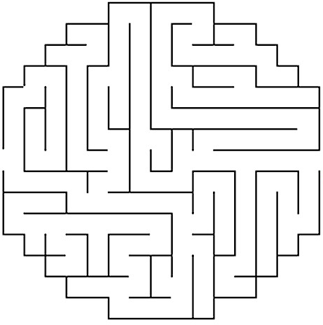
Write an algorithm that you could use to find a path through the following maze.

Slide 4


Slide 6
Two styles of Traversal
Depth First Search
This type of algorithm will follow a single pathway, choosing its path at each junction until it reaches a terminating condition where it will then backtrack to the last position where it had to make a choice and choose a different path from there.
Breadth First Search
This type of algorithm checks all neighbours of visited nodes in an ever expanding net until it reaches the optimum solution.

Slide 7
DFS

Slide 8
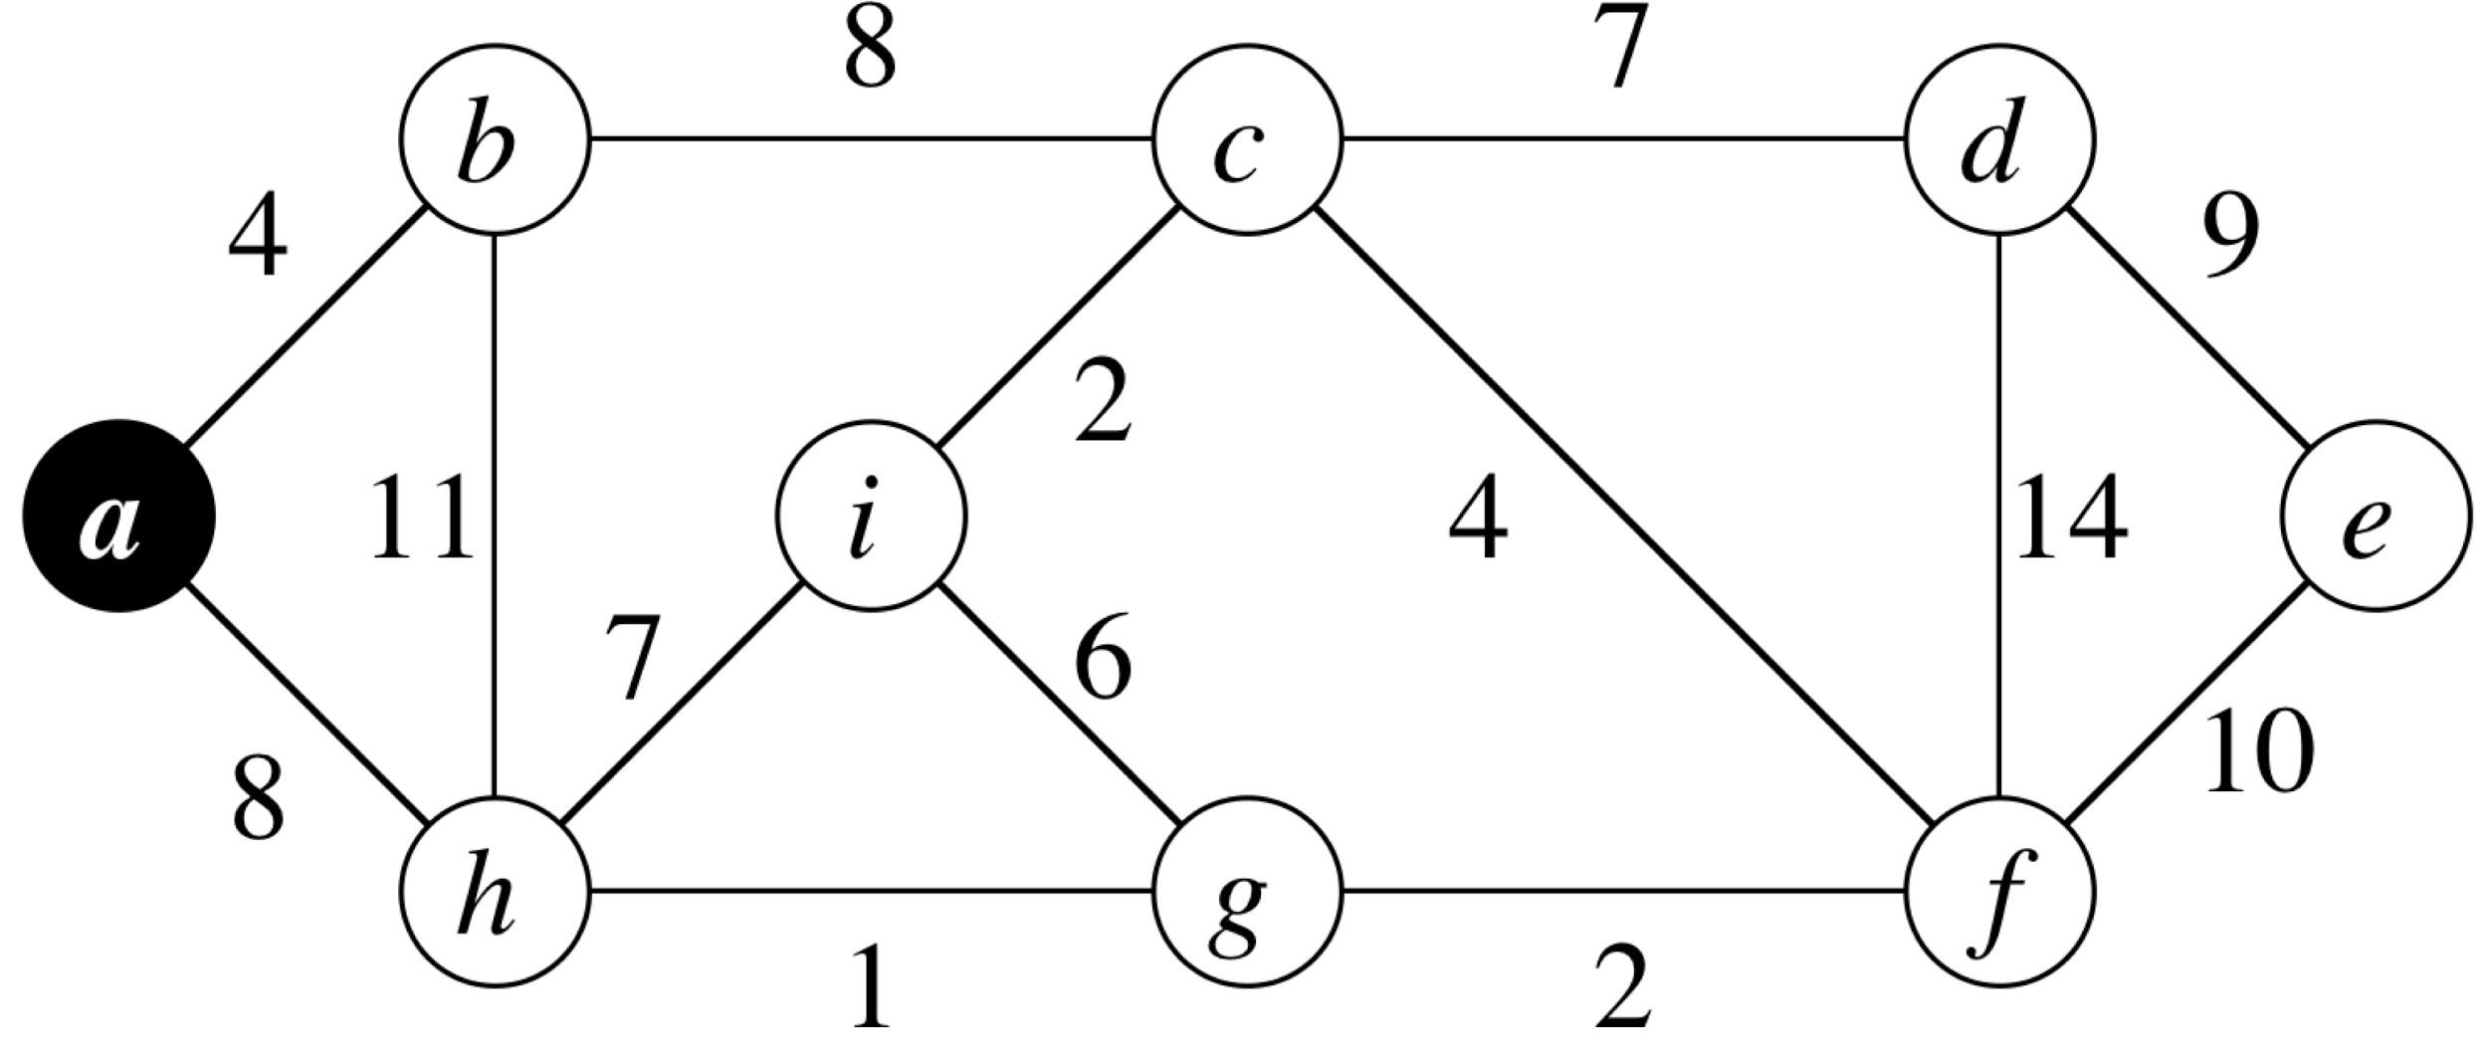
DFS | a
BFS | a

Slide 9
DFS | a
BFS | a

Slide 10
DFS | a
BFS | a

Slide 11
DFS | a
BFS | a

Slide 12
DFS | a
BFS | a

Slide 13
DFS | a
BFS | a

Slide 14
DFS | a
BFS | a

Slide 15
DFS | a
BFS | a

Slide 16
DFS | a
BFS | a

Slide 17
DFS | a | b | c | d | e | f | g | i | h
BFS | a

Slide 18
a

Slide 19
a

Slide 22
h, b

Slide 23
h, b

Slide 24
h, b

Slide 25
h

Slide 26
h

Slide 27
h, c

Slide 28
h, c

Slide 29
h, c

Slide 30
h

Slide 31
h, i, f, d

Slide 32
h, i, f, d

Slide 33
h, i, f, d

Slide 34
h, i, f

Slide 35
h, i, f, e

Slide 36
h, i, f, e

Slide 37
h, i, f, e

Slide 38
h, i, f

Slide 39
h, i, f

Slide 40
h, i, f

Slide 41
h, i

Slide 42
h, i, g

Slide 43
h, i, g

Slide 44
h, i, g

Slide 45
h, i

Slide 46
h, i

Slide 47
h, i

Slide 48
h

Slide 49
h

Slide 50
h

Slide 52
BFS

Slide 53
DFS | a | b | c | d | e | f | g | h | i
BFS | a

Slide 54
DFS | a | b | c | d | e | f | g | h | i
BFS | a

Slide 55
DFS | a | b | c | d | e | f | g | h | i
BFS | a

Slide 56
DFS | a | b | c | d | e | f | g | h | i
BFS | a

Slide 57
DFS | a | b | c | d | e | f | g | h | i
BFS | a

Slide 58
DFS | a | b | c | d | e | f | g | h | i
BFS | a

Slide 59
DFS | a | b | c | d | e | f | g | h | i
BFS | a

Slide 60
DFS | a | b | c | d | e | f | g | h | i
BFS | a

Slide 61
DFS | a | b | c | d | e | f | g | h | i
BFS | a

Slide 62
DFS | a | b | c | d | e | f | g | h | i
BFS | a | b | h | c | g | i | d | f | e

Slide 63
a

Slide 64
a

Slide 67
b, h

Slide 68
b, h

Slide 69
h

Slide 70
h, c

Slide 71
h, c

Slide 72
h, c

Slide 73
c

Slide 74
c, g, i

Slide 75
c, g, i

Slide 76
c, g, i

Slide 77
g, i

Slide 78
g, i, d, f

Slide 79
g, i, d, f

Slide 80
g, i, d, f

Slide 81
i, d, f

Slide 82
i, d, f

Slide 83
d, f

Slide 84
d, f

Slide 85
d, f

Slide 86
f

Slide 87
f

Slide 88
f, e

Slide 89
f, e

Slide 90
e

Slide 91
e

Slide 92
e

Slide 94
But what about our Maze idea?
Best First Search
Sometimes you want a ‘rule of thumb’ to go by, like “always take the left turn when it’s available” or “always head in the direction closest to the exit” etc. This is called Best First Search and uses the idea of Heuristics (rules of thumb) to decide on what the best choice is at any decision point.

Slide 96
Rule : Always choose the lowest weighted edge from the most recently visited node
Best FS | a

Slide 97
Rule :
Best FS | a

Slide 98
Rule :
Best FS | a

Slide 99
Rule :
Best FS | a

Slide 100
Rule :
Best FS | a

Slide 101
Rule :
Best FS | a

Slide 102
Rule :
Best FS | a

Slide 103
Rule :
Best FS | a

Slide 104
Rule :
Best FS | a

Slide 105
Rule :
Best FS | a | b | c | i | g | h | f | e | d

Slide 106
Rule : Always choose the lowest weighted edge leading to ANY unvisited nodes
Best FS | a

Slide 107
Rule :
Best FS | a

Slide 108
Rule :
Best FS | a

Slide 109
Rule :
Best FS | a

Slide 110
Rule :
Best FS | a

Slide 111
Rule :
Best FS | a

Slide 112
Rule :
Best FS | a

Slide 113
Rule :
Best FS | a

Slide 114
Rule :
Best FS | a

Slide 115
Rule :
Best FS | a | b | h | g | f | c | i | d | e

Slide 116
Code up a BFS for the following graph
nodes = [[0,74,212], [1,144,166], [2,238,154], [3,322,135], [4,389,182], [5,308,214], [6,242,287], [7,145,259], [8,208,231]] for n in nodes: new_node = graph.add_node(id =n[0]) new_node.set_position(n[1], n[2], relative = False) edges = [[0,1,4], [2,1,8], [3,2,7], [4,3,9], [5,4,10], [3,5,14], [5,6,2], [5,2,4], [7,6,1], [0,7,8], [1,7,11], [8,7,7], [8,6,6], [8,2,2]] for e in edges: new_edge = graph.add_edge(graph.node(e[0]), graph.node(e[1]), weight = graph.node(e[2]))

